Slide 1
Machine Learning

Slide 2
Linear Regression
Linear Equation: represent relationship between x and y and has exponential of 1 means the power of x and y is equal to 1.
And it's represented as line on graph and the points on the line show us the solved equation.

Slide 3
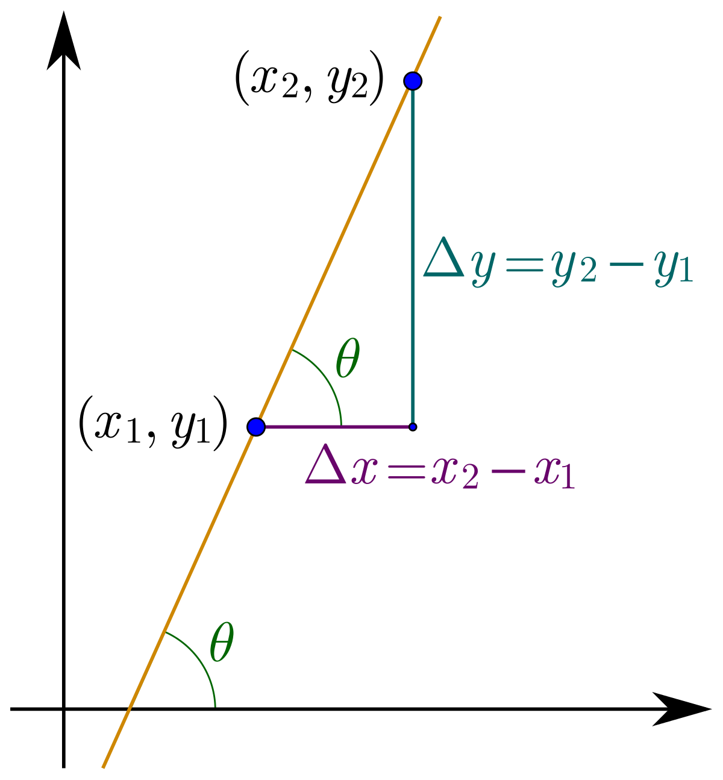
Slope
Straight line slope = 0.
In the image slope is positive.
Otherwise is negative.

Slide 4

Different types of slope

Slide 5
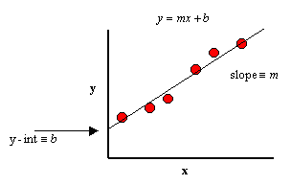
Linear Equation Formula
Have some points in table of x,y and try to get the relationship between them.
y=mx + b

Slide 6
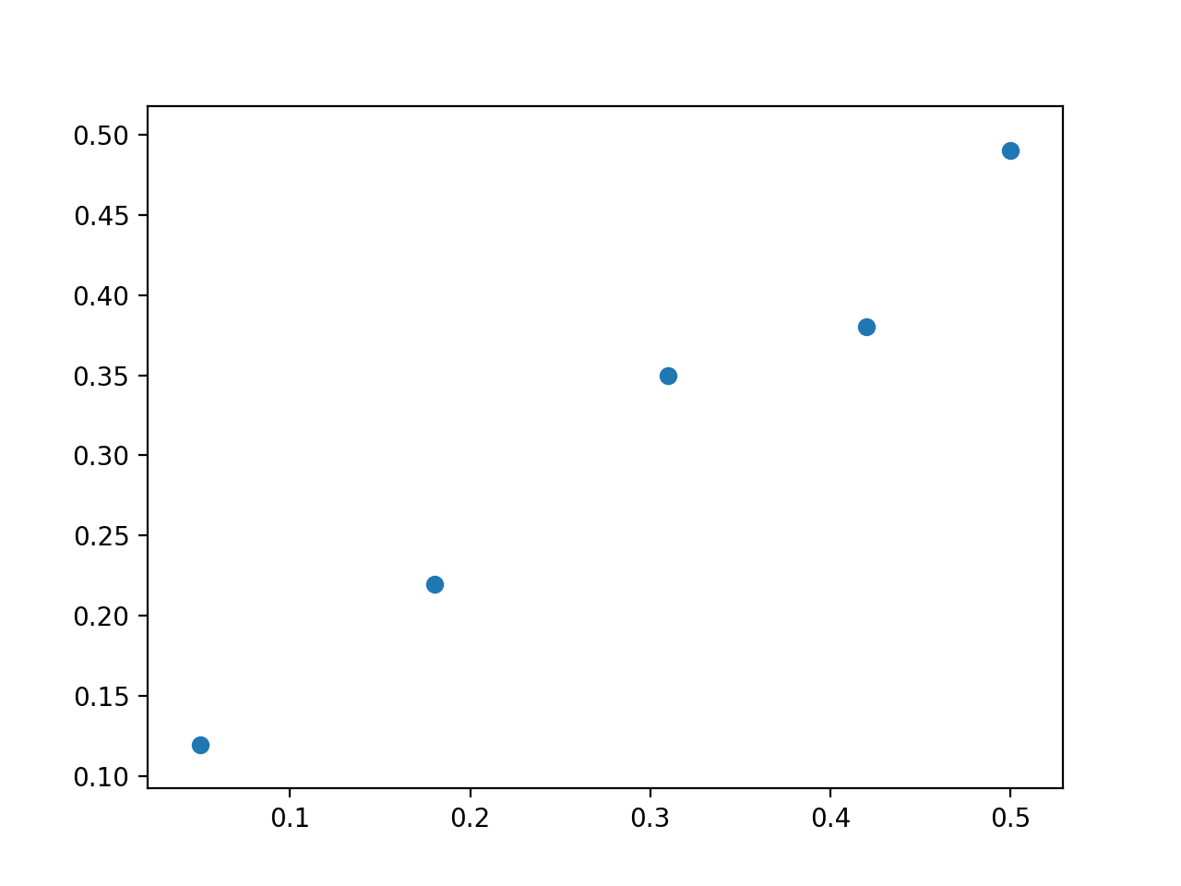
Linear Regression Problem
All of us has notation as some name so when I call you to solve this problem and then say your name, so the data set has some notation we should dealing with via these notations.

Slide 7
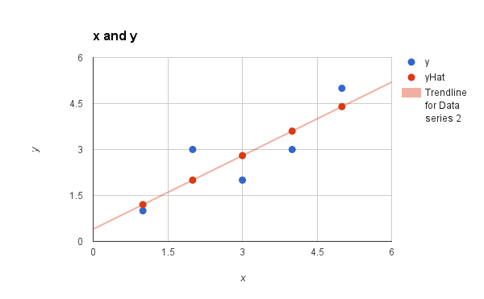
Dataset Notations
x^{(i)} is the (i) input training example also called feature.
y^{(i)} is the (i) output of training example.
(x^{(i)}, y^{(i)}) is called a training example.
and the dataset that we’ll be using to learn —a list of m training examples.
Y-hat = hypothesis-h(x) = predict, the equation we will use to predict the output.
n = number of features for each training example.
Theta or Weights (Θ) or W = Parameters of equation (the most thing we interest in).
J(Cost ) = The error over all our dataset.
X(Capital) = all inputs examples.
Y(Capital) = all output examples.

Slide 8
Graph with different notations
The actual point is far away of predicting line and that what's called error we need to minimize
y-intercept
slope
y-hat
y-hat=mx + b
Actual y
Y
Fitting Line
(x^{(i)}, y^{(i)})
y-intercept=b
Y-hat or h(x) hypothesis is the predicted value of y at point x like at the arrow we predict that line and at x the y is another value but the actual value y is
X

Slide 9
The most important Thing we care about:
-- Minimizing The Cost Function --

Slide 10
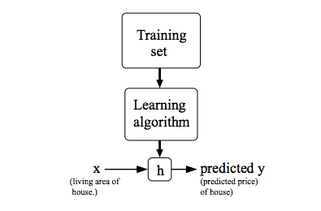
Y-hat
The most thing we need is to minimize is the distance or squared error between the predicted value y-hat and the real value y.
So we have a training set passing to learning algorithm then for each of x value try to predict y-hat which will be compared with real y to know its good predict or not.

Slide 11
NOTE ..!
When the target variable that we’re trying to predict is continuous, such as housing price example, we call the learning problem a regression problem. When y can take on only a small number of discrete values (such as if, given the image, we wanted to predict if a cat or dog ), we call it a classification problem.

Slide 12
Little bit changes.
Y-hat or h(x)= θ₀ + θ₁x
The same equation but we change just the variables and all of we need to said about these two variables theat 0 and theta 1 is the parameters of our equation.
Actually these two parameters.
As we know our linear equation from previous slides was y=mx + b
And we said that equation will be used to predict y-hat,so will change it to a new form.

Slide 13
Math behind the equation !
let θ₀ = 0 and θ₁= .5 so
Y = 1 + 0
let θ₀ = 1 and θ₁ = .5 so
Y = 1 + 0
let θ₀ = 1 and θ₁ = 0 so
Y = 1 + 0

Slide 14

Cost Function or Squared error function
We can measure the accuracy of our hypothesis function by using a cost function. This takes an average difference between all of y-hat and real y.

Slide 15
h(x) or Y-hat or predicted
Y-hat or h(x)= θ₀ + θ₁x
Thetas value is fixed for this equation but in cost function we try to change these parameters which help us minimize the cost function.
Let us take this example and draw the x,y and the cost function when change theta 1 and theta 0 = 0.
Input(x) | output(y)
1 | 1
2 | 2
3 | 3

Slide 16
Theta 1 = 0 and Theta 0 = 0
Y-hat or h(x)= 0+ 0
The fitting line will be on x-axis because theta 1 = 0
Y-hat or h(x)= 0+ 2x
because theta 1 = 2
Theta 1 = 2
Theta 0 = 0
Y-hat or h(x)= 0+ x
because theta 1 = 1
We should notice that while we change the theta 1 our equation is affected.
But we still have no knowledge its good or not predict. “So use cost function to validate this”.
we see the vertical distance from our fit to the data points increase with different values of thetas
Theta 1 = 1
Theta 0 = 0
4
3
2
1
Theta 1 = 0
Theta 0 = 0
1
2
3

Slide 17
The cost through the difference of Theta 1 when theta 0 = 0
Y-hat or h(x)= 0+ 0 when theta 1 = 0
The cost will be = 2.3 !
Let us calculate this.
Y-hat or h(x)= 0+ x when theta 1 = 1
The cost will be = 0
Let us calculate this.
Y-hat or h(x)= 0+ 2x when theta 1 = 2
The cost will be ..? try it yourself.
Now you can see how the cost function change throughout change values of theta so all we need is to tune these parameter in a way that minimize the cost function to global minimum
3
x
x
2
x
J(θ )
x
1
x
1
θ₁
2
3

Slide 18
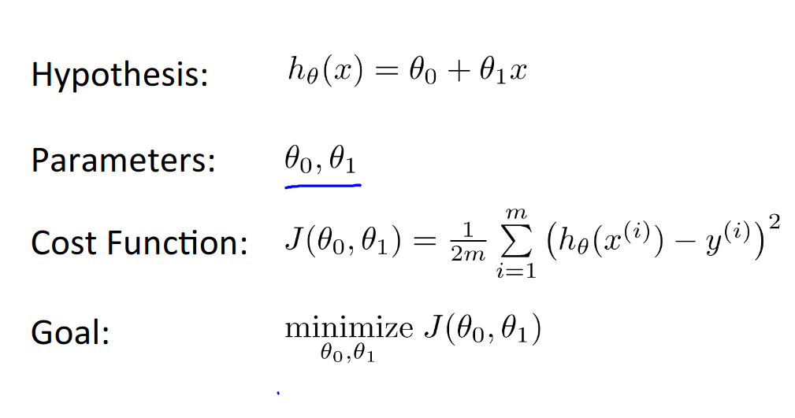
Linear Equation & Parameters & cost function
Some of the images used from online ML Course by Andrew NG

Slide 19
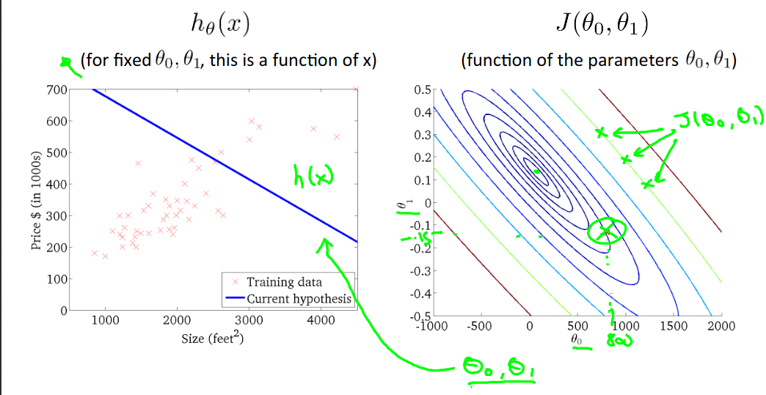
Example with different values of theta 0 and theta 1

Slide 20
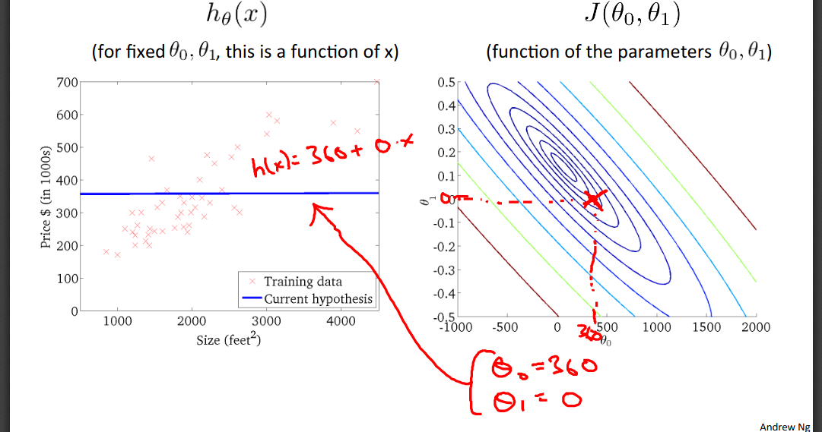
Continuous

Slide 21
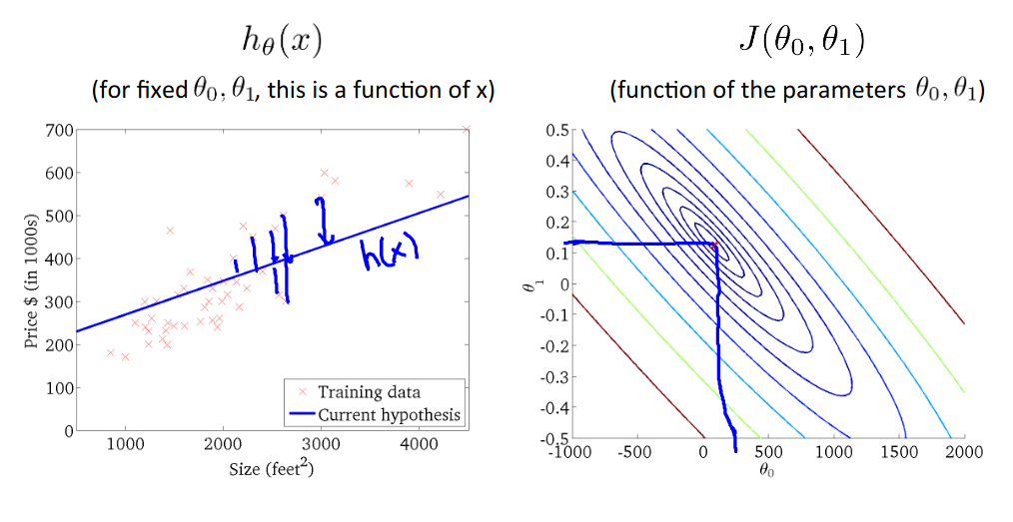
Continuous

Slide 22

Learning Parameters & Gradient Descent

